Slide 1
Project 1
By D’Ante Jolly

Slide 2
About The Project
Used data from Wikipedia
Used HDFS and Hive as my main tool.
I did not use MapReduce in Hadoop itself.
Storage and resources was a major issue.
A lot of issues with Linux

Slide 3
Which English wikipedia article got the most traffic on October 20?

Slide 4
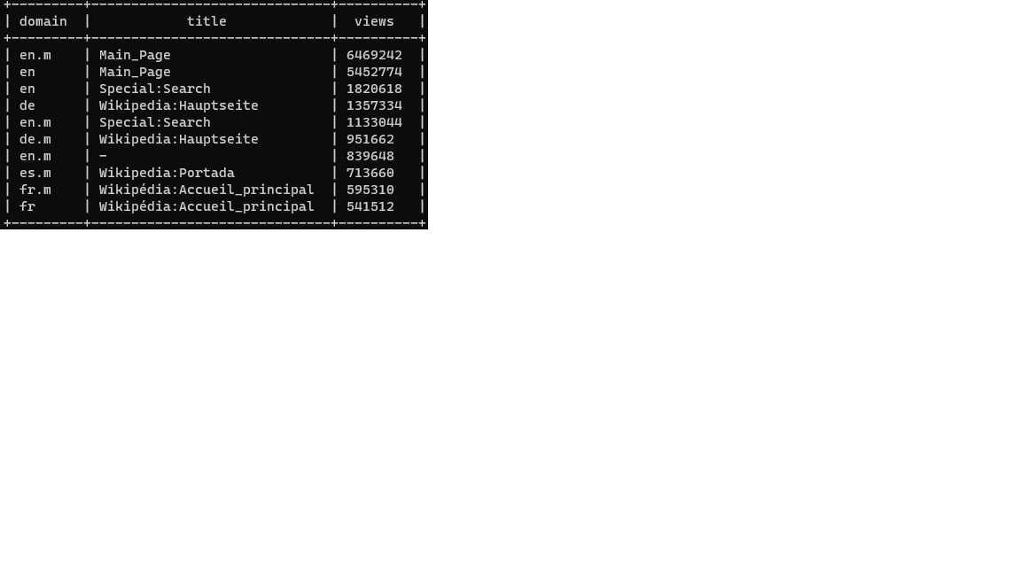
Q1
Highest English article was the main page.
No further analysis was put forth

Slide 5
Which English wikipedia article got the most traffic on October 20?

Slide 6
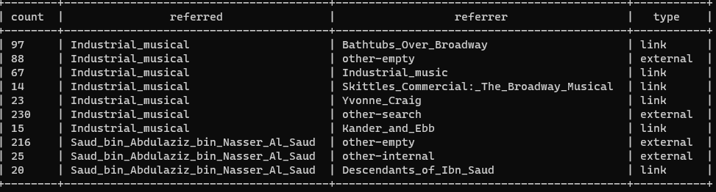
Q2 starting
Ran a general search query

Slide 7
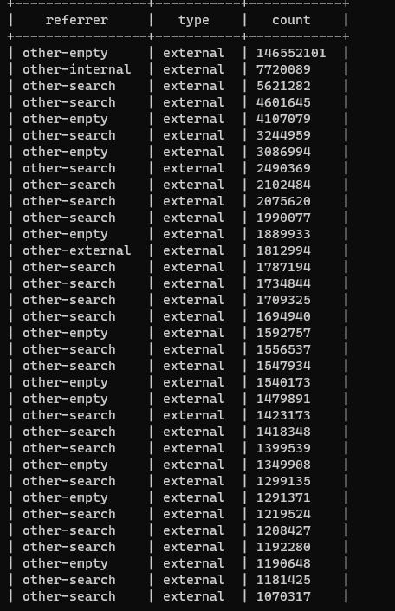
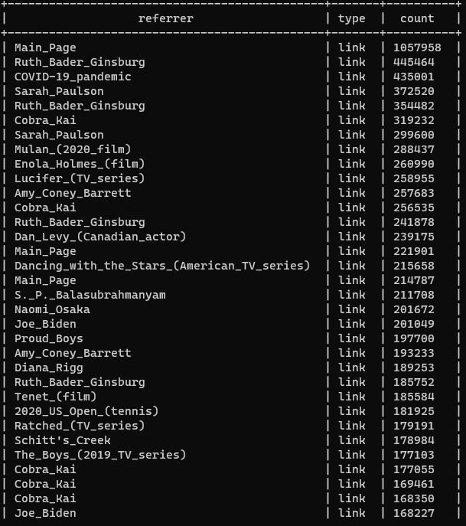
Q2 separating types

Slide 8
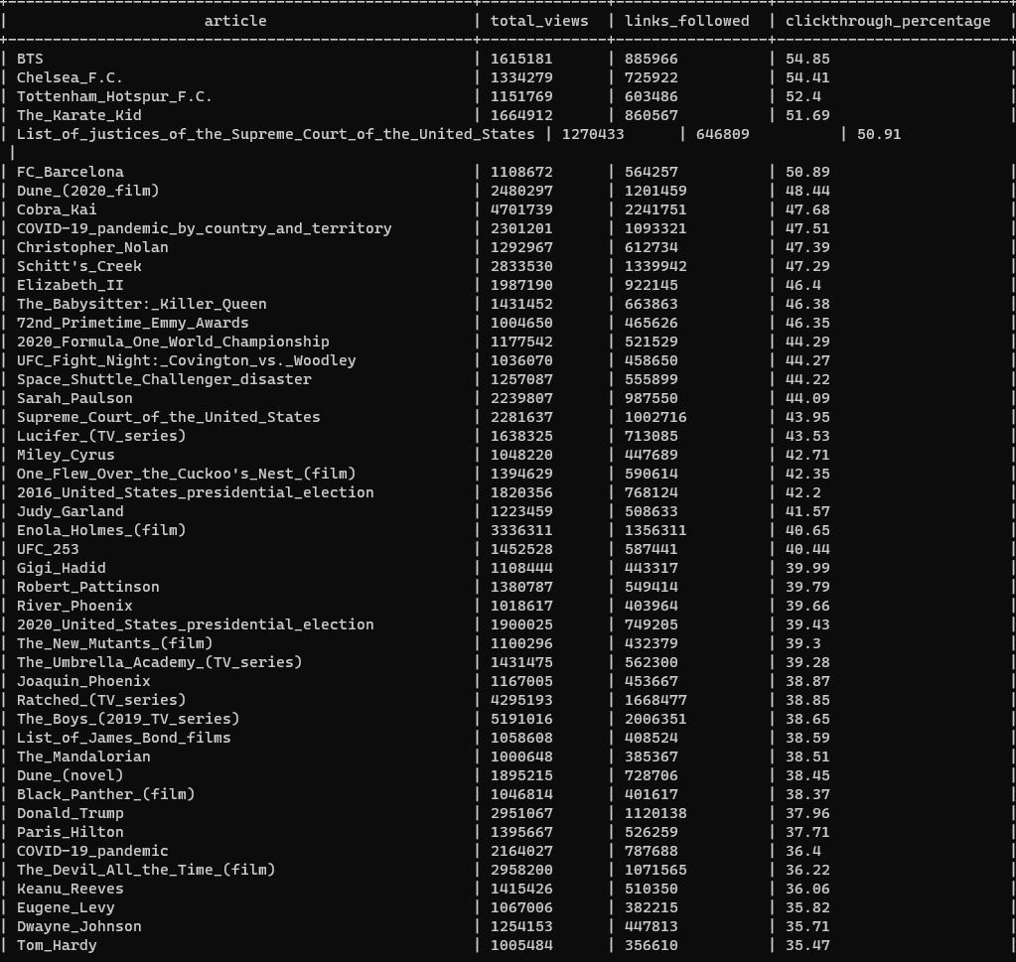
Q2 Final
Total views of a page was used to divide the links followed to get internal link percentage.

Slide 9
What series of wikipedia articles, starting with Hotel California, keeps the largest fraction of its readers clicking on internal links? This is similar to (2), but you should continue the analysis past the first article.

Slide 10
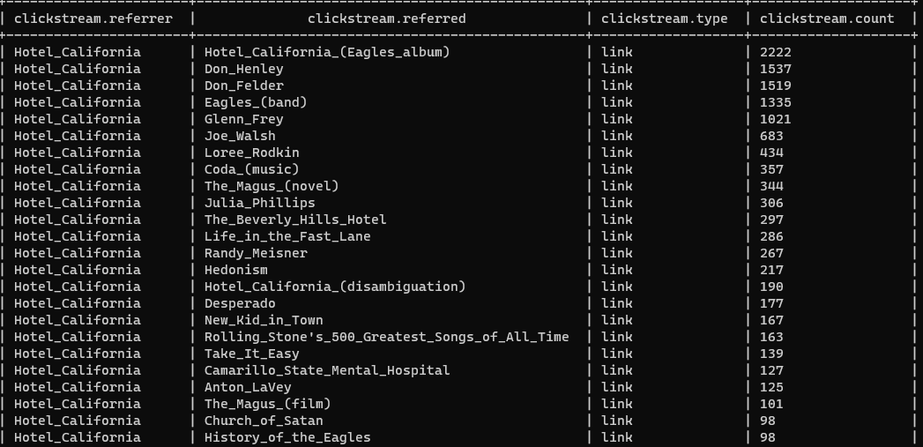

Q3 starting

Slide 11
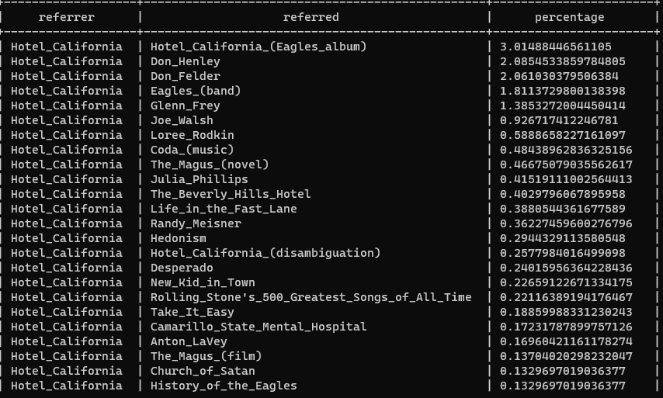
Q3 Percentages
Looked at percentages to give me largest fraction.

Slide 12
Chain of queries
"Hotel_California“
"Hotel_California_(Eagles_album)"
"The_Long_Run_(album)"
"Eagles_Live"
"Eagles_Greatest_Hits,_Vol._2"
"The_Very_Best_of_the_Eagles"
"Hell_Freezes_Over"
"Selected_Works:_1972–1999“
"The_Very_Best_Of_(Eagles_album)“
"Eagles_(box_set)"

Slide 13
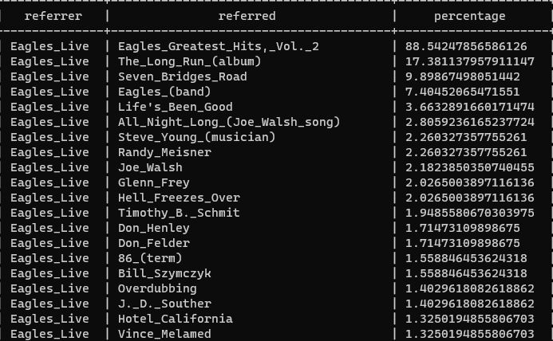
Q3 Answer
Eagles Box set was found to be largest

Slide 14
Find an example of an English wikipedia article that is relatively more popular in the UK. Find the same for the US and Australia.

Slide 15
Q4
https://en.wikipedia.org/wiki/Internet_rush_hour
https://www.worldtimeserver.com/current_time_in_UTC.aspx
Concluded that UK 7-11 pm so hours would 19-23
Too match UTC hours were set 13-18
US would 15-23 based on UTC
Australia was the same as US 14-22
Each hour dataset was downloaded in their own folder to be used in their own table.

Slide 16
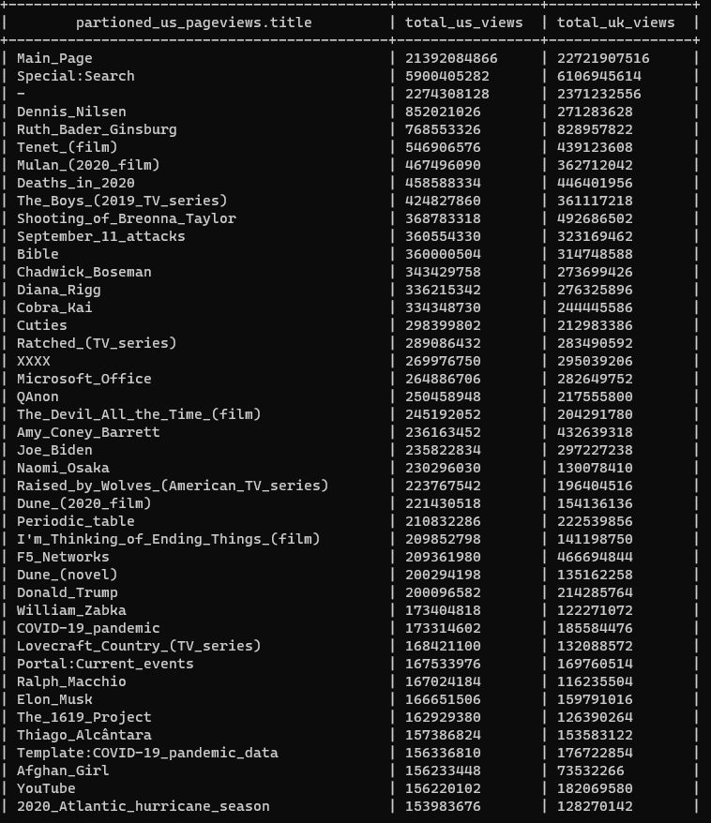
Q4 USA to UK
We can see that Ruth_Bader_Ginsburg was an article that was more popular in the UK than the US.
Covid 19 pandemic was popular article in the UK as well.

Slide 17
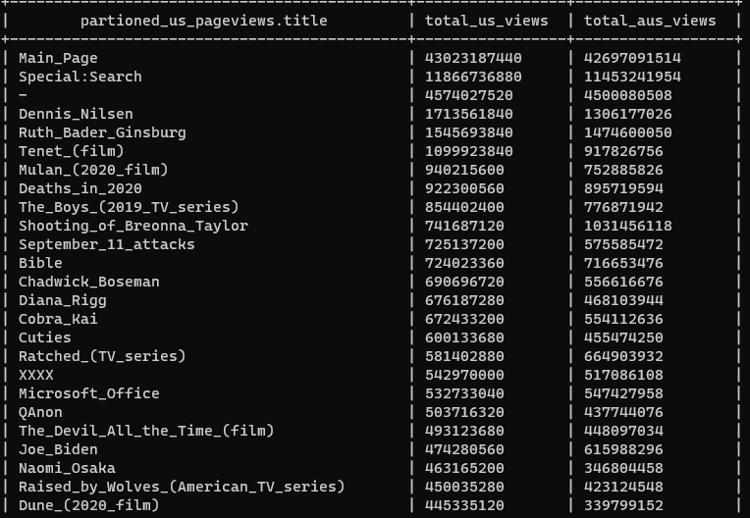
Q4 USA to AUS
Shooting_ Breonna_Talyor was significally more popular in Australia to the USA.

Slide 18
Q5
Utilized time and pageviews to eventually get my answer
Utilized the average time it takes for revision to be identified in a month.
Multiplied that with the average views Wikipedia article gets and divided by the amount seconds in a day

Slide 19

Q5
Average amount of views a popular page gets before its revised

Slide 20
Q6 Looking for the most revised article
Began a query search on the media enwiki data set to find the most revised article.
I wanted to find a popular media property that was likely to receive the most revisions.

Slide 21
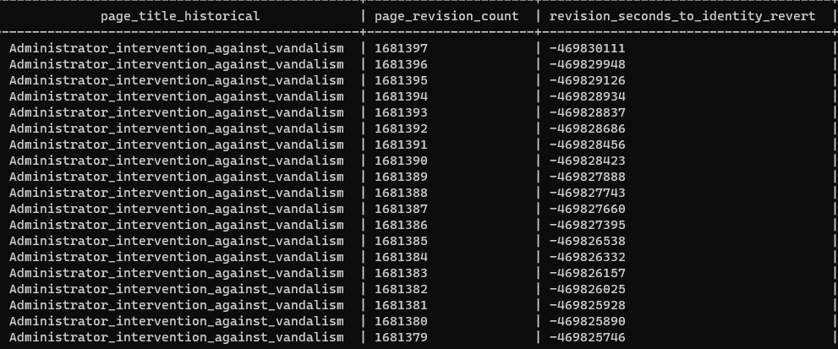

Slide 22
Tried to find data on it in clickstream

Slide 23
https://en.wikipedia.org/wiki/Wikipedia_talk:Administrator_intervention_against_vandalism
Turns it is not a site was more of legal document with no links so no one is likely to be click to.

Slide 24
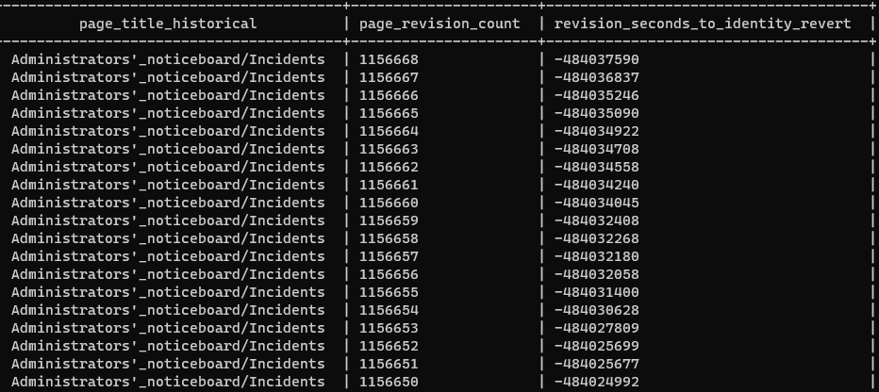

Slide 25
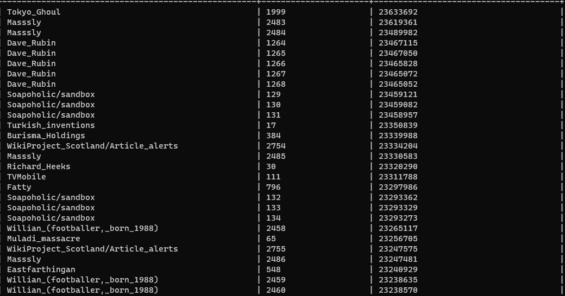
Changed revision in seconds to identify

Slide 26

Media: Tokyo Ghoul
The interest me because it had a large seconds to identify revision but has been revised 1999 times in September.
My question was why was it revisions catches so slow.

Slide 27
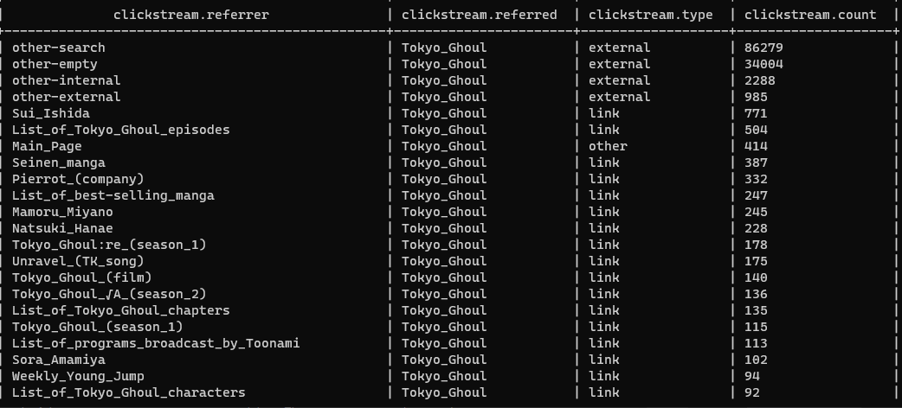
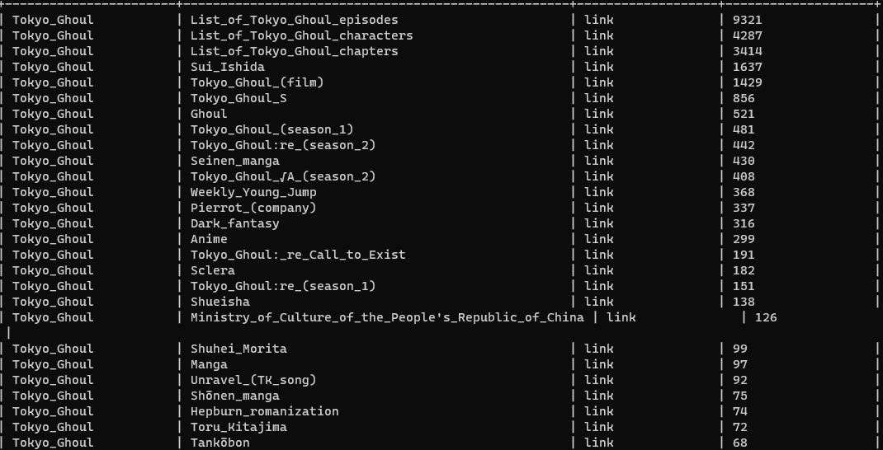
Links

Slide 28
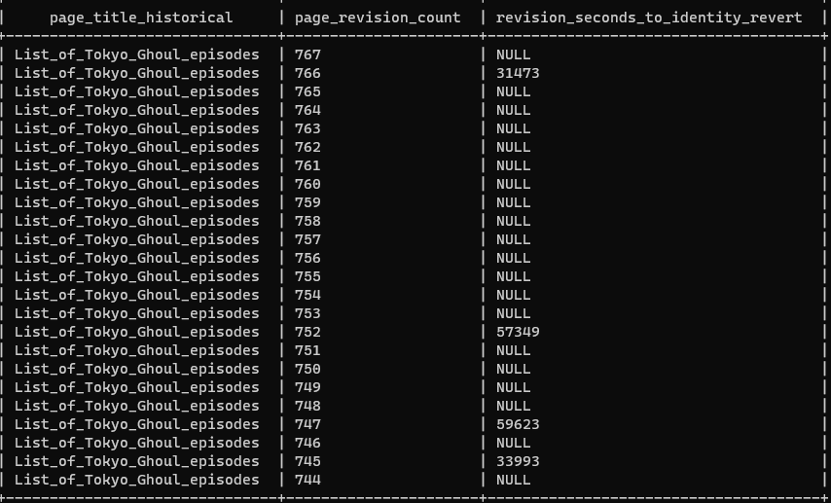
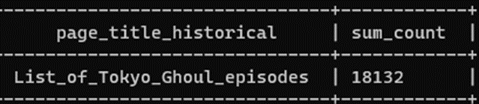
Answer

Slide 29
Thank you

